Slide 1
Fundamental Limits of Learning: Computation and Applications
Grant No: W911NF-16-1-0561
FunLoL Half-year Meeting
Mar 20-21, 2017
Vahid Tarokh
Professor of Applied Mathematics
Harvard University
Joint Effort with Finale Doshi-Valez and Leslie Valiant

Slide 2
Outline of Key Findings
Definition of the limit of learning for vector-time series
Shannon like formula for LoL in well-specified parametric cases
Numerical algorithms and software for LoL computation
Relationship with model selection
LoL-inspired model selection penalty
Proof of consistency in well-specified cases
Superior performance for small amount of data.
Generalization of TIC
Proof of the asymptotic efficiency of generalized TIC
LoL in mis-specified scenarios
Surrogates of the limit of learning for arbitrary data
Computation algorithms
Online implementation
Non-identifiability
Limits of Learning in cognitive setting
Future work

Slide 3
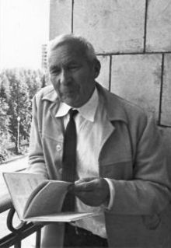
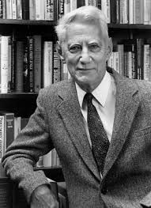
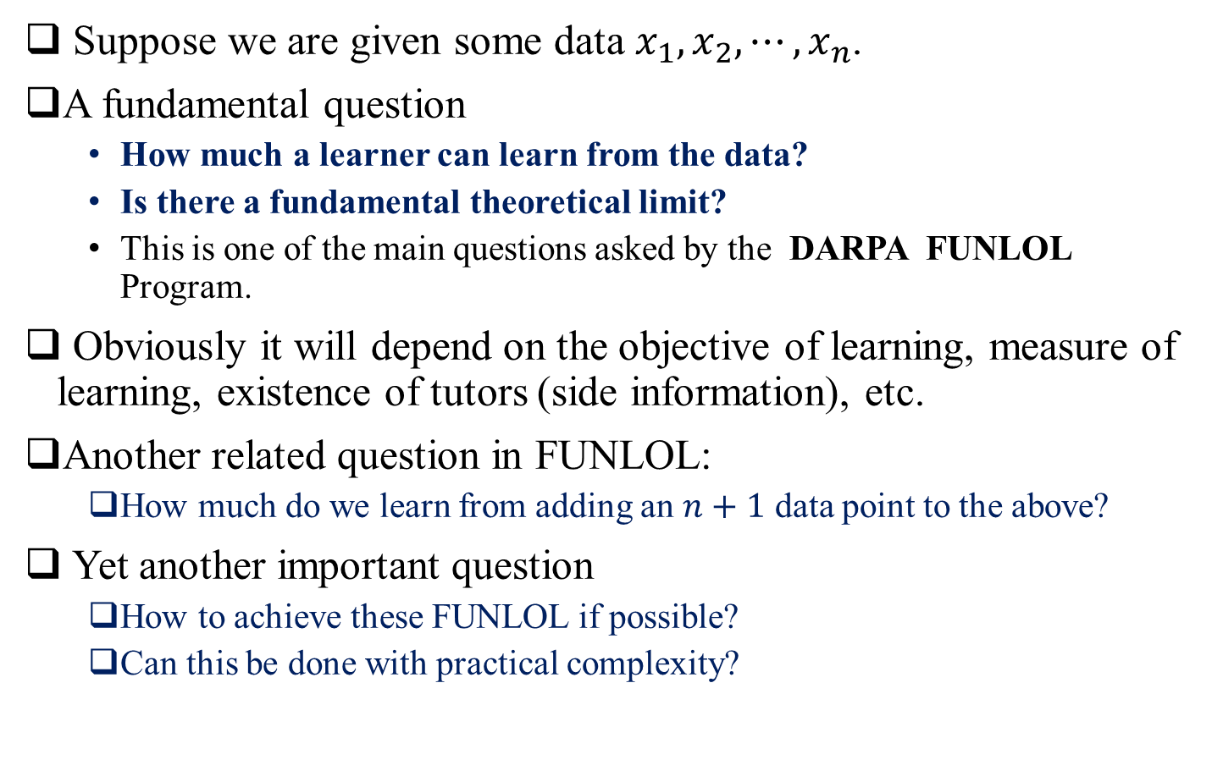
Motivation
Suppose we are given some data $x_{1}, x_{2}, ⋯, x_{n}$.
A fundamental question
How much a learner can learn from the data?
Is there a fundamental theoretical limit?
This is one of the main questions asked by the DARPA FUNLOL Program.
Obviously it will depend on the objective of learning, measure of learning, existence of tutors (side information), etc.
Another related question in FUNLOL:
How much do we learn from adding an $n+1$ data point to the above?
Yet another important question
How to achieve these FUNLOL if possible?
Can this be done with practical complexity?

Slide 4
Motivation
Why is this important:
It is intellectually interesting (to the point that great mathematician A.N. Kolmogorov has worked on it).
Such limits can be used for comparison of the performance of existing algorithms.
If the measure of learning is out of sample predictive error, then achieving the limit of learning can have many applications (predicting the future in the best way).
Interestingly, the by-products of our studies improve on the classical model selection algorithms.

Slide 5
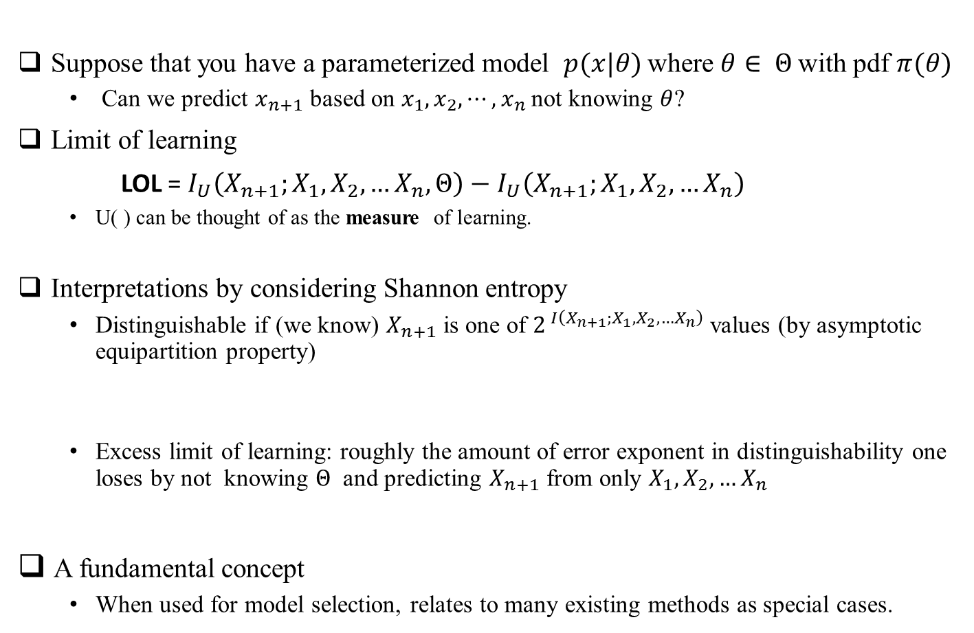
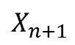
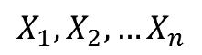
The Parametrized Well-Specified Case
Suppose that you have a parameterized model $p(x|θ)$where $θ∈ Θ$with pdf $π(θ)$
Can we predict $x_{n+1}$ based on $x_{1}, x_{2}, ⋯, x_{n}$not knowing $θ$?
Limit of learning
LOL = $I_{U}\left(X_{n+1};X_{1}, X_{2}, …X_{n},Θ\right)−I_{U}\left(X_{n+1};X_{1}, X_{2}, …X_{n}\right)$
U( ) can be thought of as the measure of learning.
Interpretations by considering Shannon entropy
Distinguishable if (we know) $X_{n+1}$ is one of $2^{ I\left(X_{n+1};X_{1}, X_{2}, …X_{n}\right)}$ values (by asymptotic equipartition property)
Excess limit of learning: roughly the amount of error exponent in distinguishability one loses by not knowing $Θ$ and predicting $X_{n+1}$ from only $X_{1}, X_{2}, …X_{n}$
A fundamental concept
When used for model selection, relates to many existing methods as special cases.
$$X_{n+1}$$
Channel
$$X_{1}, X_{2}, …X_{n}$$

Slide 6
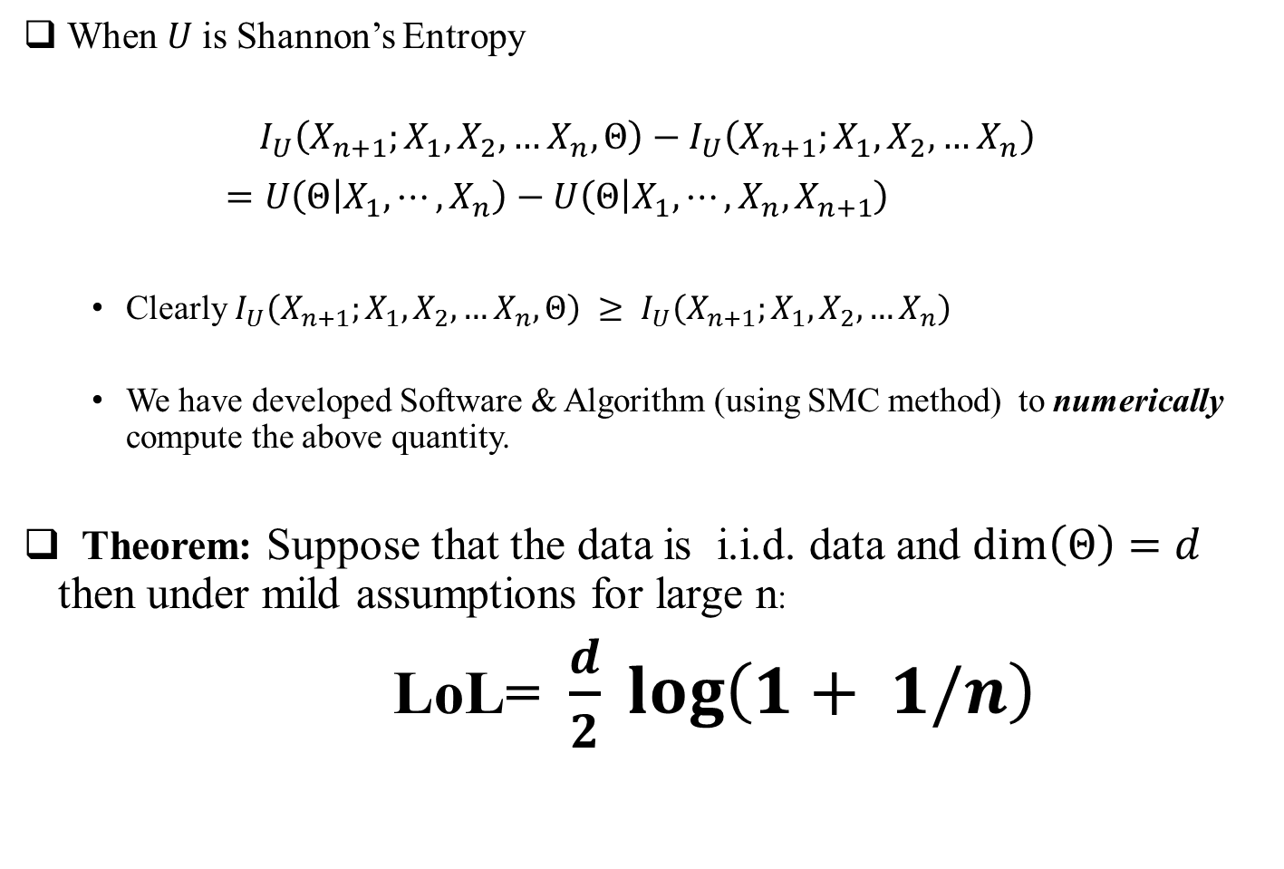
Limit of Learning
When $U$is Shannon’s Entropy
$$I_{U}\left(X_{n+1};X_{1}, X_{2}, …X_{n},Θ\right)−I_{U}\left(X_{n+1};X_{1}, X_{2}, …X_{n}\right)$$
$=U\left(Θ | X_{1}, ⋯, X_{n}\right)−U\left(Θ | X_{1}, ⋯, X_{n}, X_{n+1}\right)$
Clearly $I_{U}\left(X_{n+1};X_{1}, X_{2}, …X_{n},Θ\right) ≥ I_{U}\left(X_{n+1};X_{1}, X_{2}, …X_{n}\right)$
We have developed Software & Algorithm (using SMC method) to numerically compute the above quantity.
Theorem: Suppose that the data is i.i.d. data and $\dim\left(Θ\right)=d$ then under mild assumptions for large n:
LoL= $\frac{d}{2} log\left(1+ 1/n\right)$

Slide 7
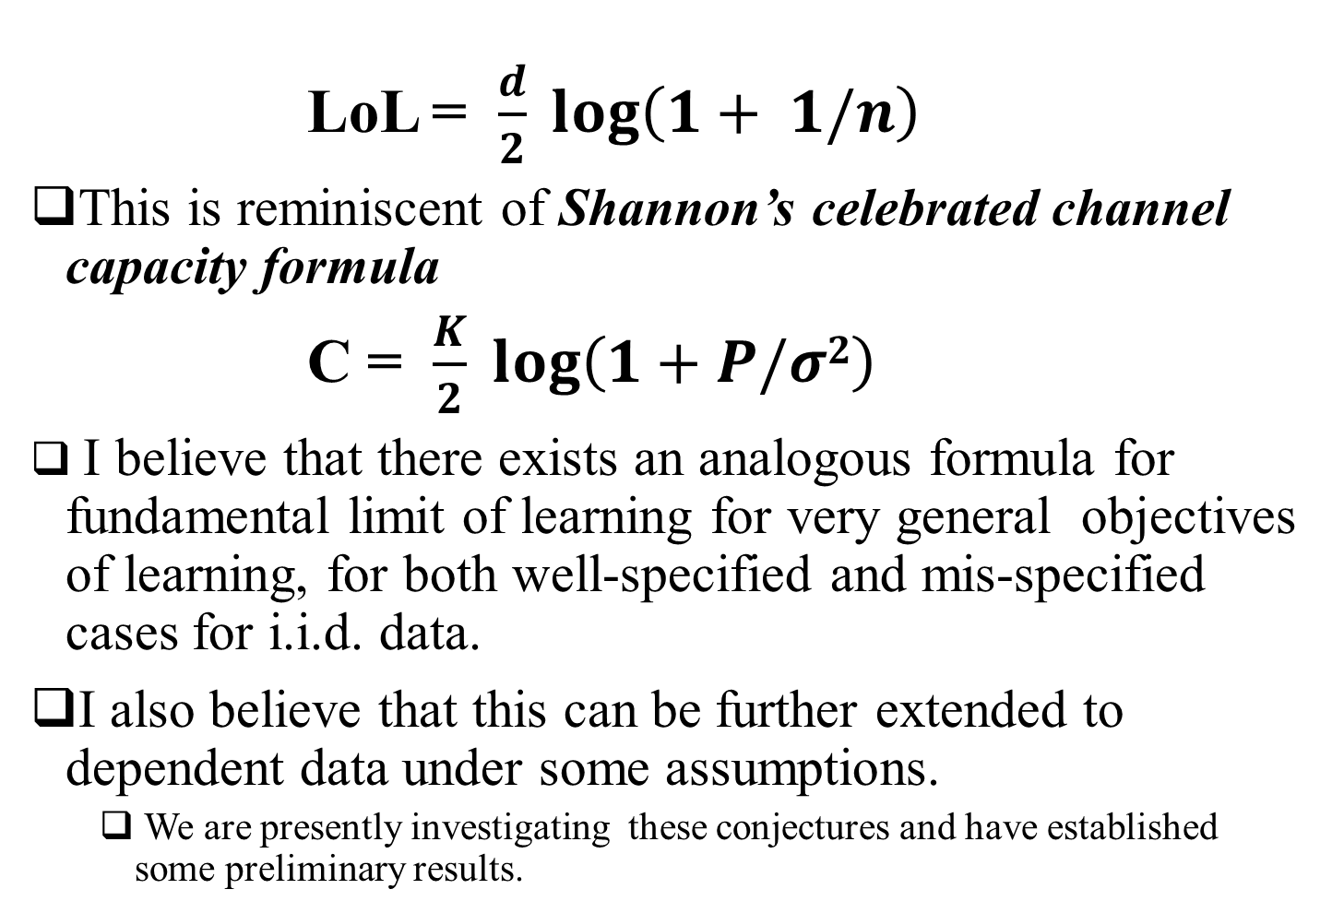
Limit of Learning
LoL = $\frac{d}{2} log\left(1+ 1/n\right)$
This is reminiscent of Shannon’s celebrated channel capacity formula
C = $\frac{K}{2} log\left(1+P/σ2\right)$
I believe that there exists an analogous formula for fundamental limit of learning for very general objectives of learning, for both well-specified and mis-specified cases for i.i.d. data.
I also believe that this can be further extended to dependent data under some assumptions.
We are presently investigating these conjectures and have established some preliminary results.

Slide 8
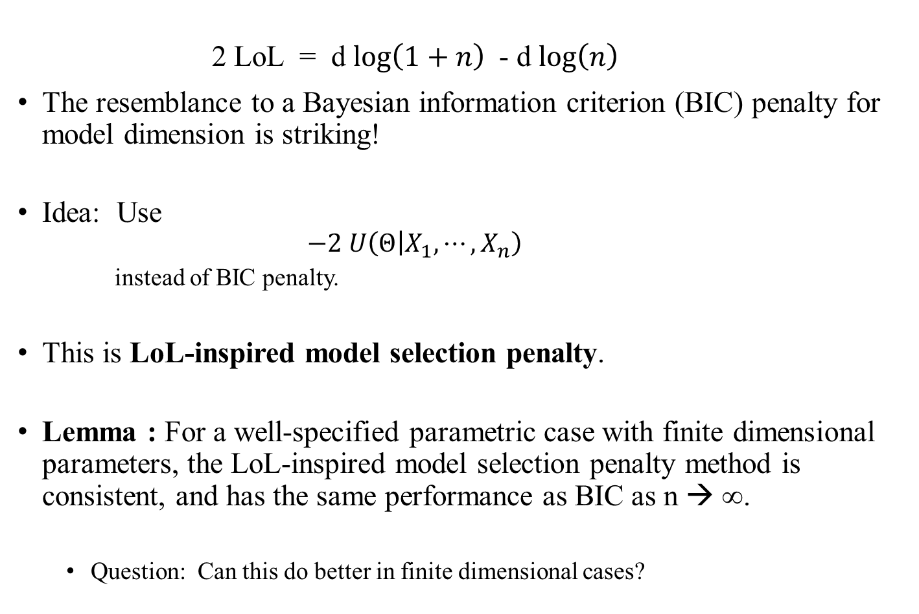
Limit of Learning
2 LoL = d $log\left(1+n\right)$ - d $log\left(n\right)$
The resemblance to a Bayesian information criterion (BIC) penalty for model dimension is striking!
Idea: Use
$$−2 U\left(Θ | X_{1}, ⋯, X_{n}\right)$$
instead of BIC penalty.
This is LoL-inspired model selection penalty.
Lemma : For a well-specified parametric case with finite dimensional parameters, the LoL-inspired model selection penalty method is consistent, and has the same performance as BIC as n → ∞.
Question: Can this do better in finite dimensional cases?

Slide 9
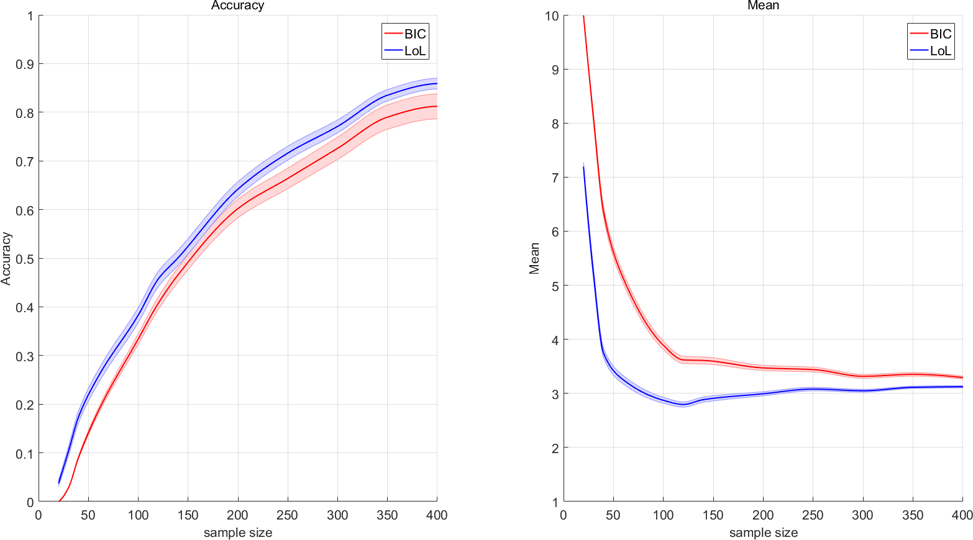
Experiment 1
Experiment: selecting the true autoregressive (AR) order from AR class of orders 1,…,10
Measure of LOL is the conditional mutual information
The true order is 3, sample size range from 20 to 400
Noise are i.i.d. standard Gaussian
Probability of correct selection
(with one standard error confidence)
Average selected order
(with one standard error confidence)

Slide 10
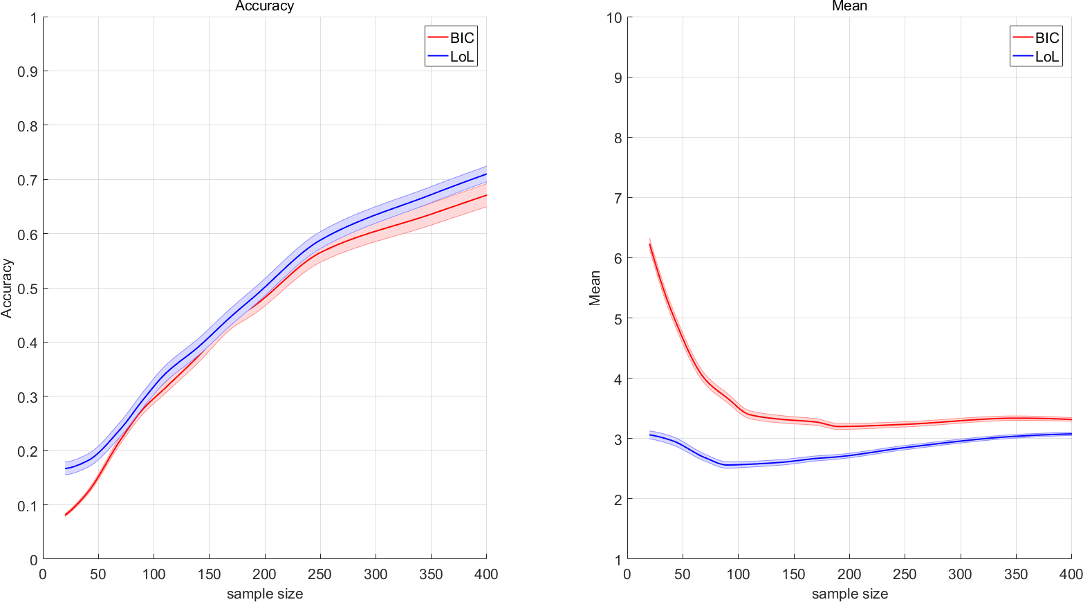
Experiment 1
Experiment: selecting the true autoregressive (AR) order from AR class of orders 1,…,10
Measure of LOL is the conditional mutual information
The true order is 3, sample size range from 20 to 400
Noise are i.i.d. standard Laplacian
Probability of correct selection
(with one standard error confidence)
Average selected order
(with one standard error confidence)

Slide 11
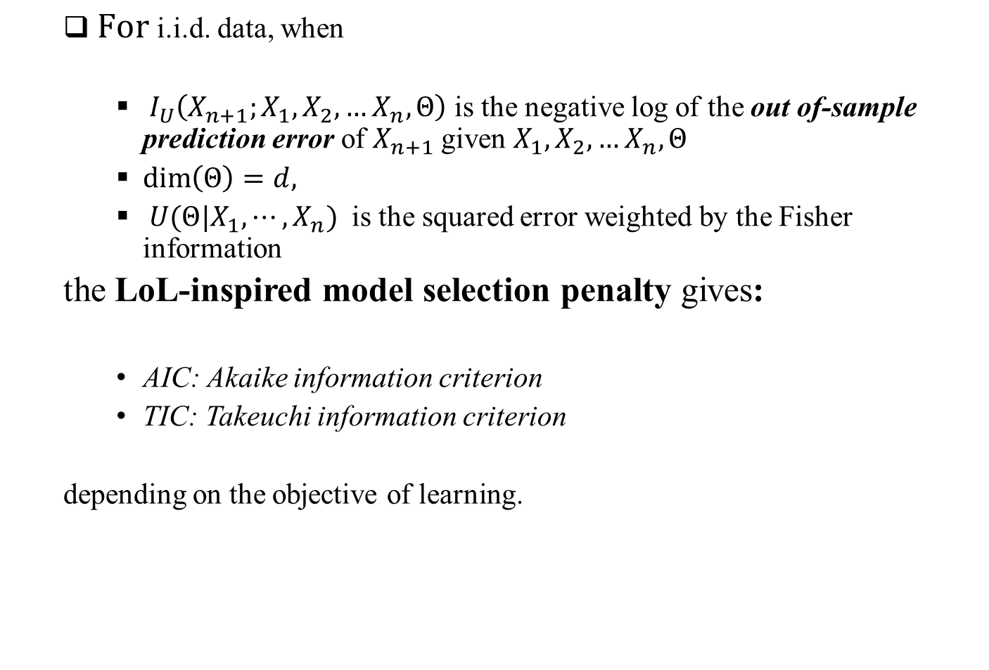
Limit of Learning
$For$i.i.d. data, when
${ I}_{U}\left(X_{n+1};X_{1}, X_{2}, …X_{n},Θ\right)$ is the negative log of the out of-sample prediction error of $X_{n+1}$ given $X_{1}, X_{2}, …X_{n},Θ$
$\dim\left(Θ\right)=d,$
$U(Θ|X_{1}, ⋯, X_{n})$ is the squared error weighted by the Fisher information
the LoL-inspired model selection penalty gives:
AIC: Akaike information criterion
TIC: Takeuchi information criterion
depending on the objective of learning.

Slide 12
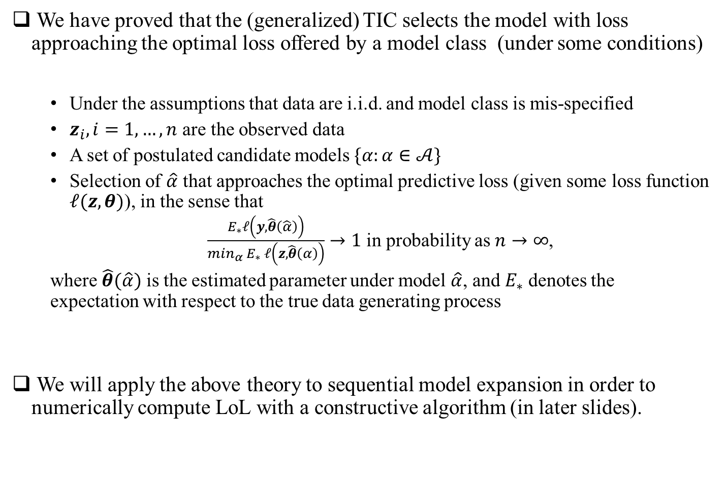
Limit of Learning: mis-specified case
We have proved that the (generalized) TIC selects the model with loss approaching the optimal loss offered by a model class (under some conditions)
Under the assumptions that data are i.i.d. and model class is mis-specified
$z_{i},i=1,…,n$ are the observed data
A set of postulated candidate models $\{α:α∈𝒜\}$
Selection of $\hat{α}$ that approaches the optimal predictive loss (given some loss function $𝓁(z,θ)$), in the sense that
$\frac{E_{∗}𝓁\left(y,\hat{θ}\left(\hat{α}\right)\right)}{min_{α} E_{∗} 𝓁\left(z,\hat{θ}\left(α\right)\right)}→1$ in probability as $n→∞$,
where $\hat{θ}(\hat{α})$ is the estimated parameter under model $\hat{α}$, and $E_{∗}$ denotes the expectation with respect to the true data generating process
We will apply the above theory to sequential model expansion in order to numerically compute LoL with a constructive algorithm (in later slides).
LoL = Reduction in log(Optimal Predictive loss) when revealing $x_{n+1}$

Slide 13
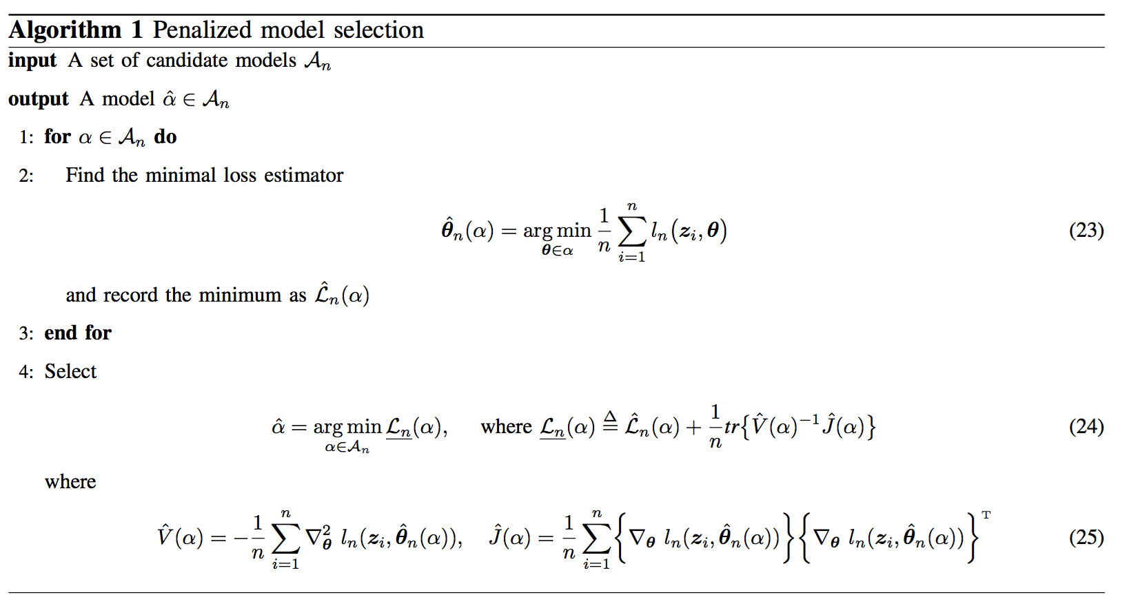

Optimal Predictive Loss from TIC
Algorithmic description (TIC)
TIC

Slide 14
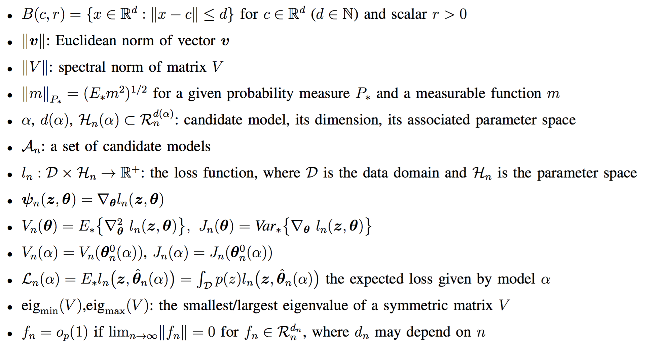
Asymptotic Efficiency of The (Generalized) TIC
Notation

Slide 15
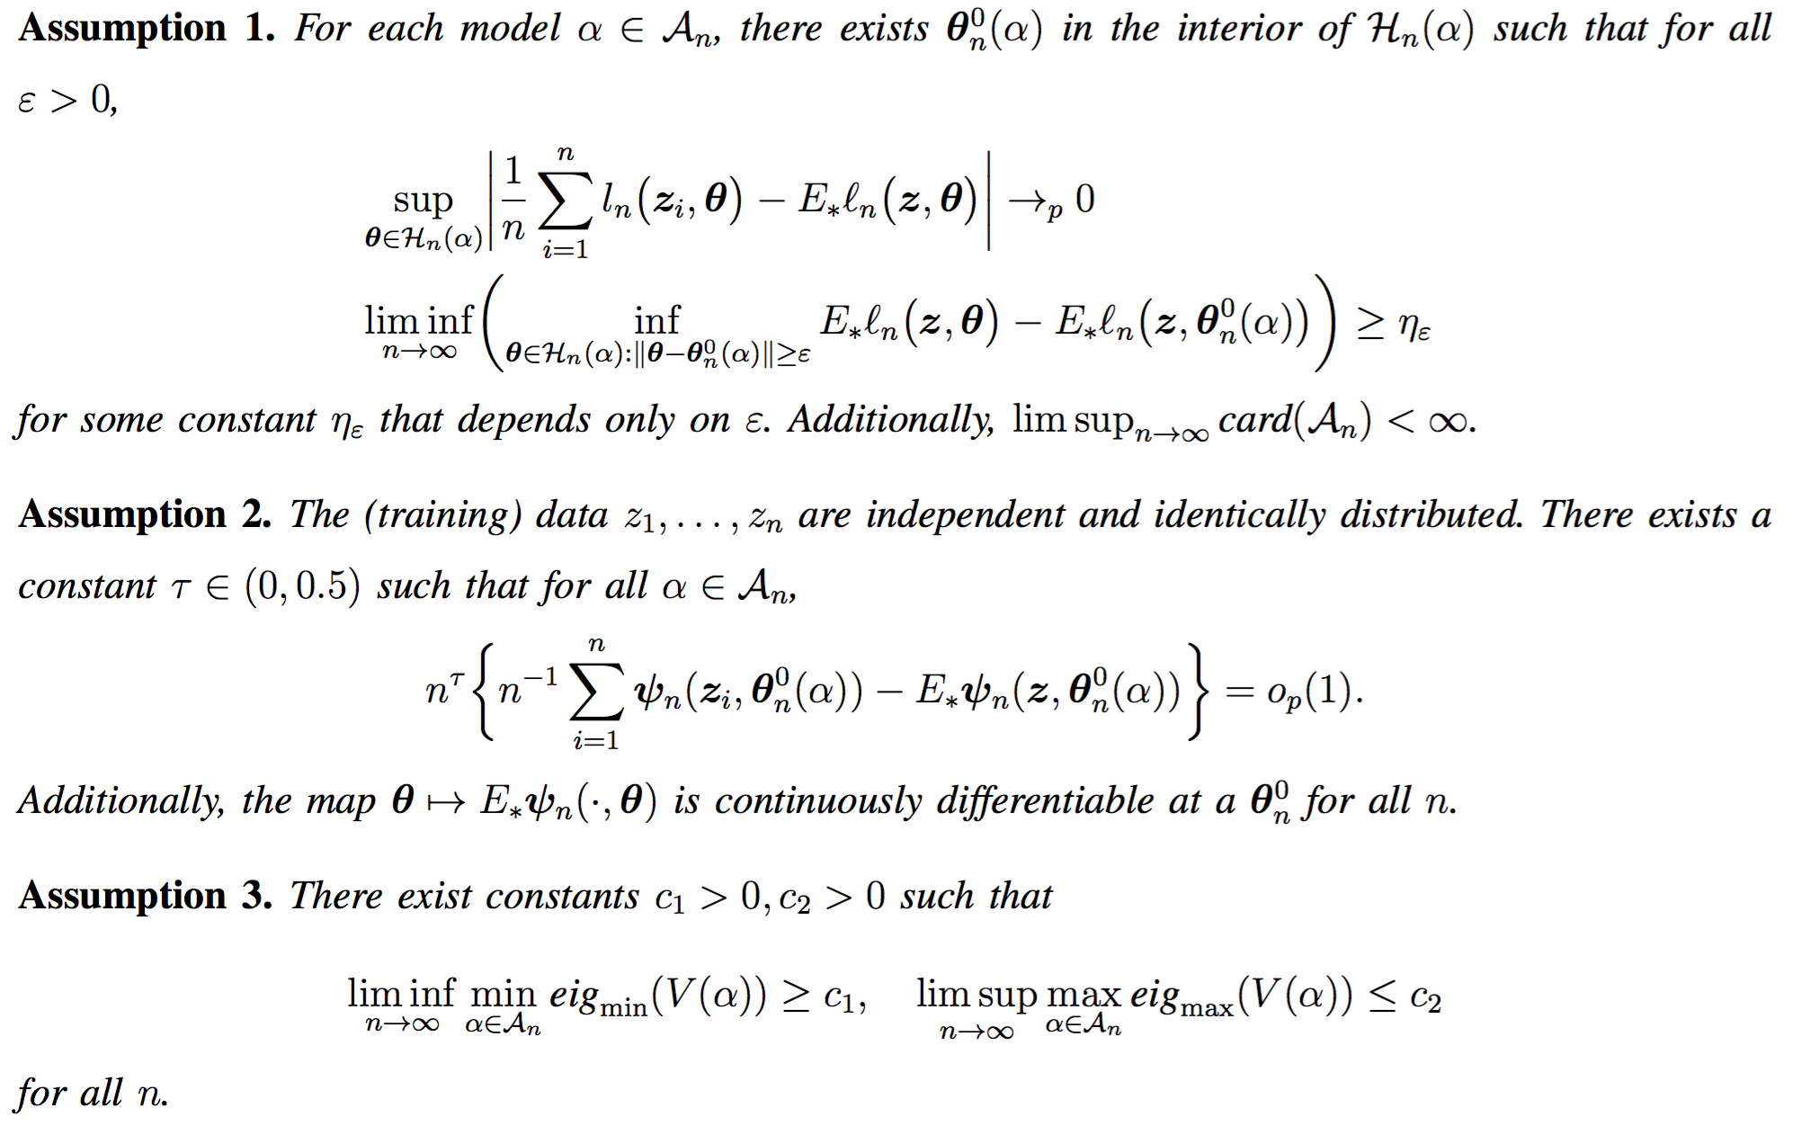
Asymptotic Efficiency of The (Generalized) TIC
Performance Analysis

Slide 16
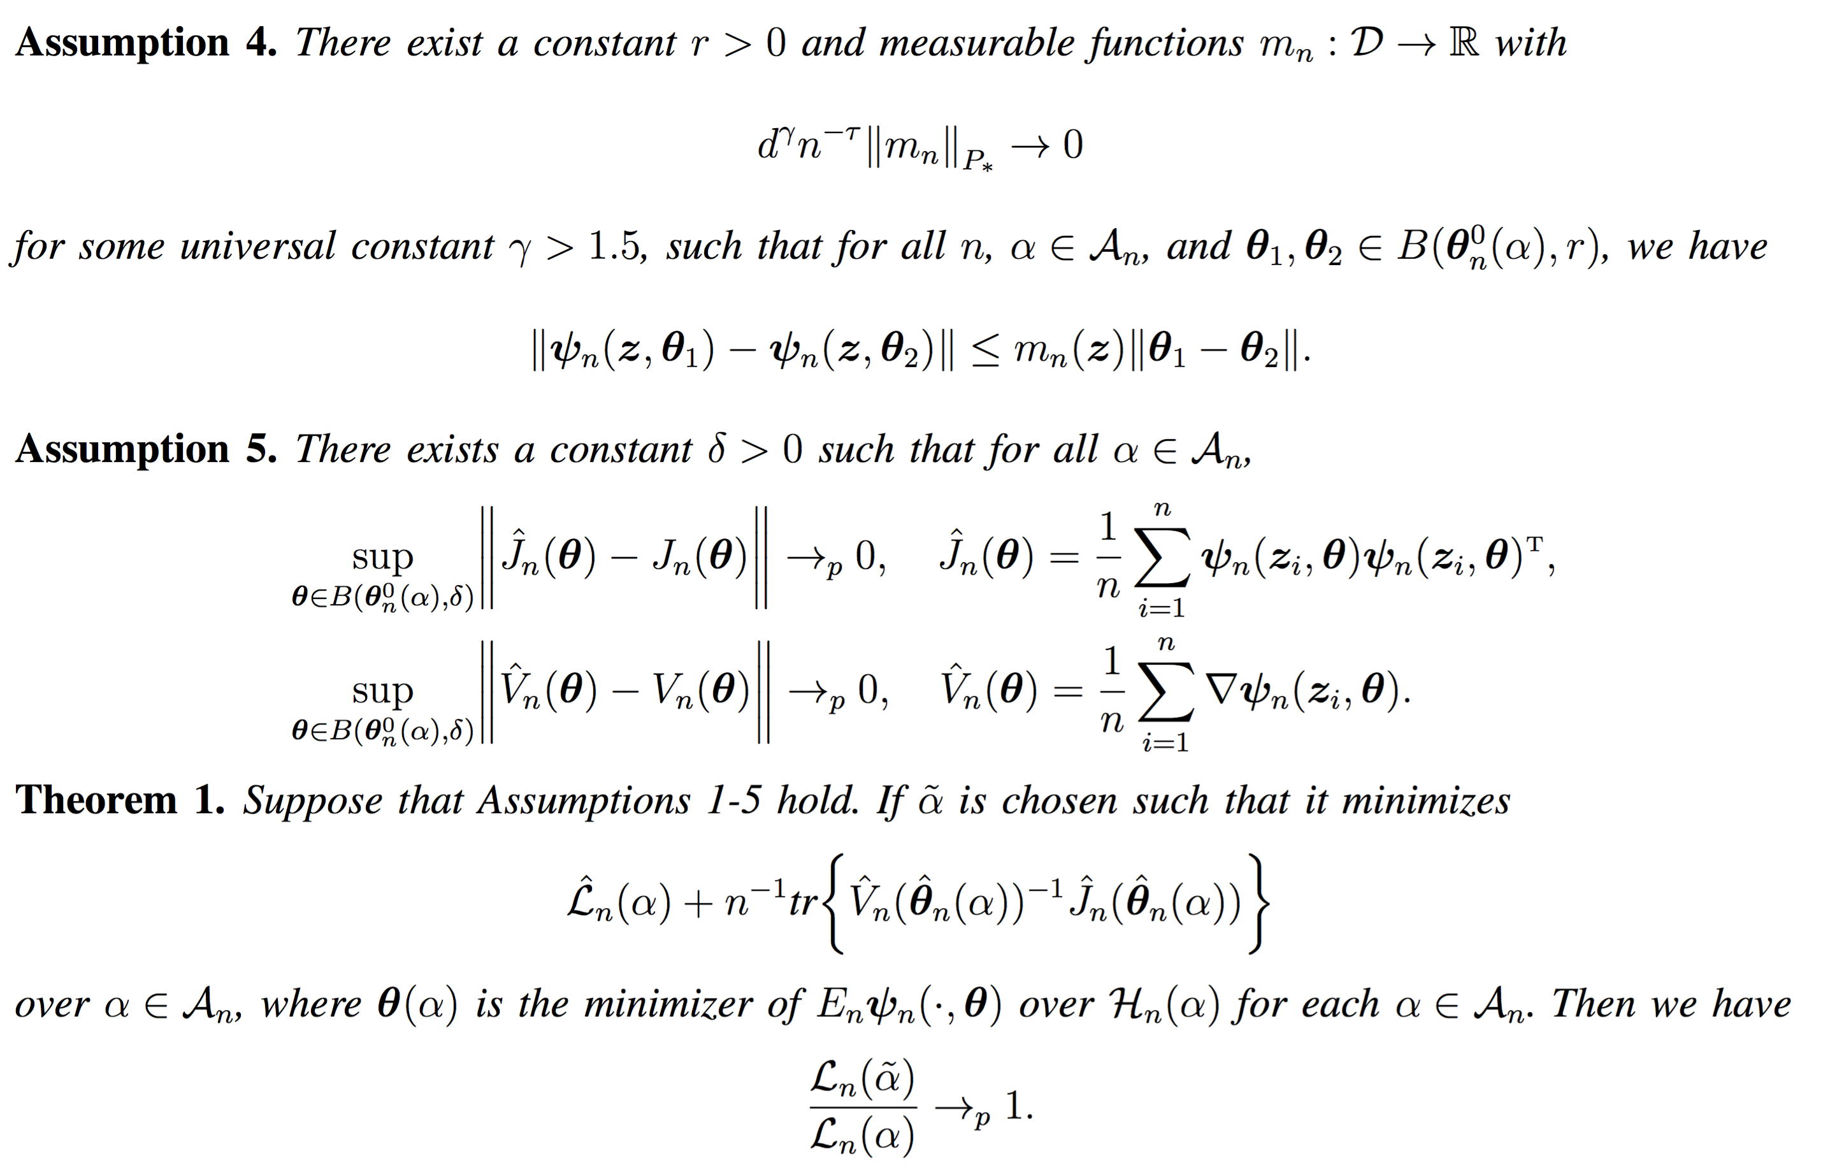
Asymptotic Efficiency of The (Generalized) TIC
Performance Analysis

Slide 17
Limit of Learning in General
What if the data are not i.i.d.?
Asymptotic performance of AIC, BIC, TIC etc. are not fully justified
In general, suppose some data is given, how to compute the limit of learning?
Some assumptions are necessary, about
Existing knowledge
Form of U( )
Dependency structure
Space of parameters / functions
General LOL
Given a parametric class
Well-specified: select the right model (vanishing LOL)
Mis-specified: select the best model offered by the class (in terms of LOL)
Not given a parametric class (subject of current research)

Slide 18
Using Surrogates
Example of surrogates (for approximating LOL)
Use cross-validation as a surrogate to approximate the prediction loss
A family of distributions specified for various dimensions
Generate reference curve to switch between different models / dimensions
Supervisors’ knowledge can accelerate learning
Reference distribution of gains numerically computed
Draw uniform samples and compute the distribution of overfitting / underfitting gains, given a parameter space
Numerically compute the gain of moving across dimensions

Slide 19
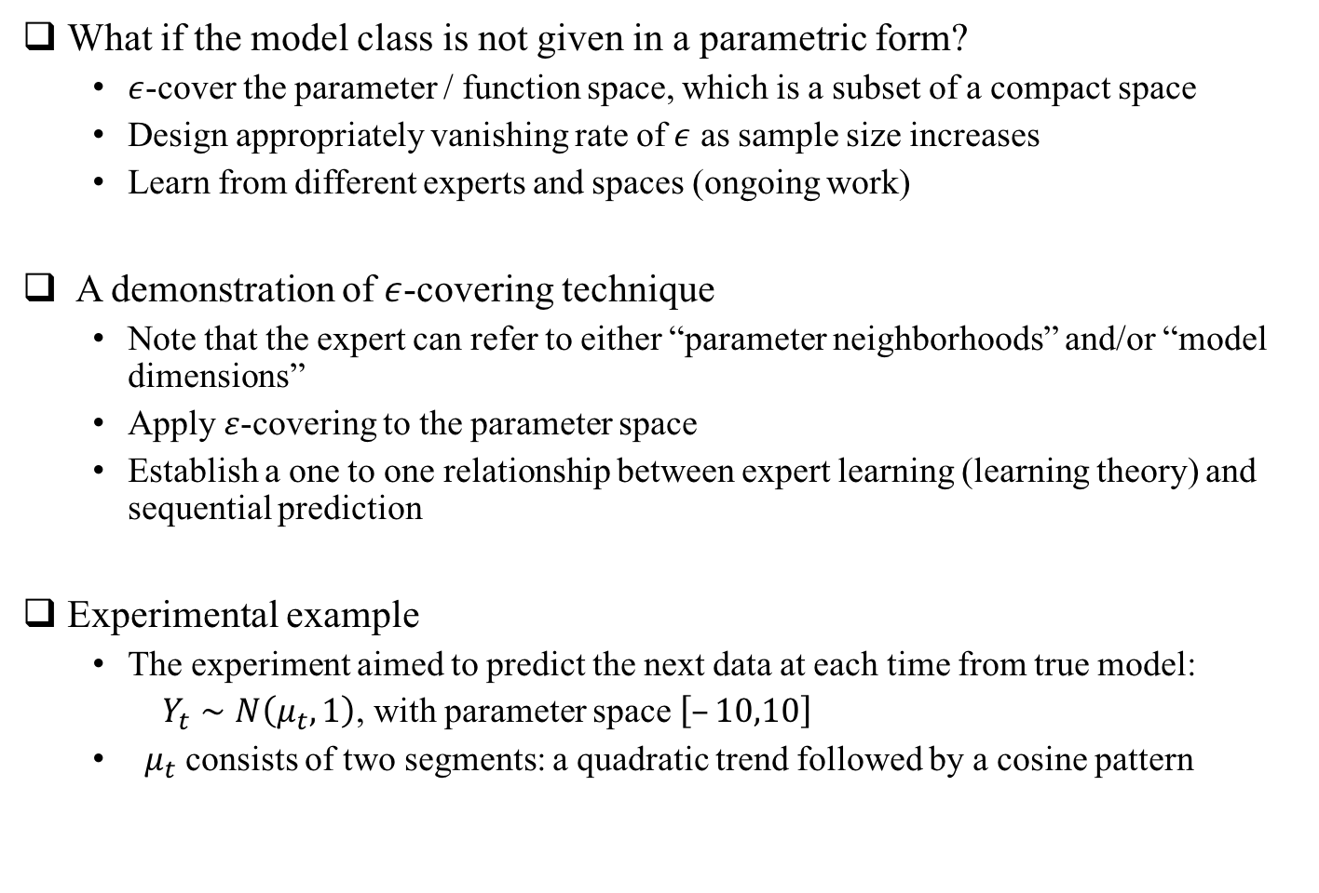
Covering Technique
What if the model class is not given in a parametric form?
$ε$-cover the parameter / function space, which is a subset of a compact space
Design appropriately vanishing rate of $ε$ as sample size increases
Learn from different experts and spaces (ongoing work)
A demonstration of $ε$-covering technique
Note that the expert can refer to either “parameter neighborhoods” and/or “model dimensions”
Apply $ε$-covering to the parameter space
Establish a one to one relationship between expert learning (learning theory) and sequential prediction
Experimental example
The experiment aimed to predict the next data at each time from true model:
$Y_{t}∼N\left(μ_{t},1\right)$, with parameter space$\left[–10,10\right]$
$μ_{t}$ consists of two segments: a quadratic trend followed by a cosine pattern

Slide 20
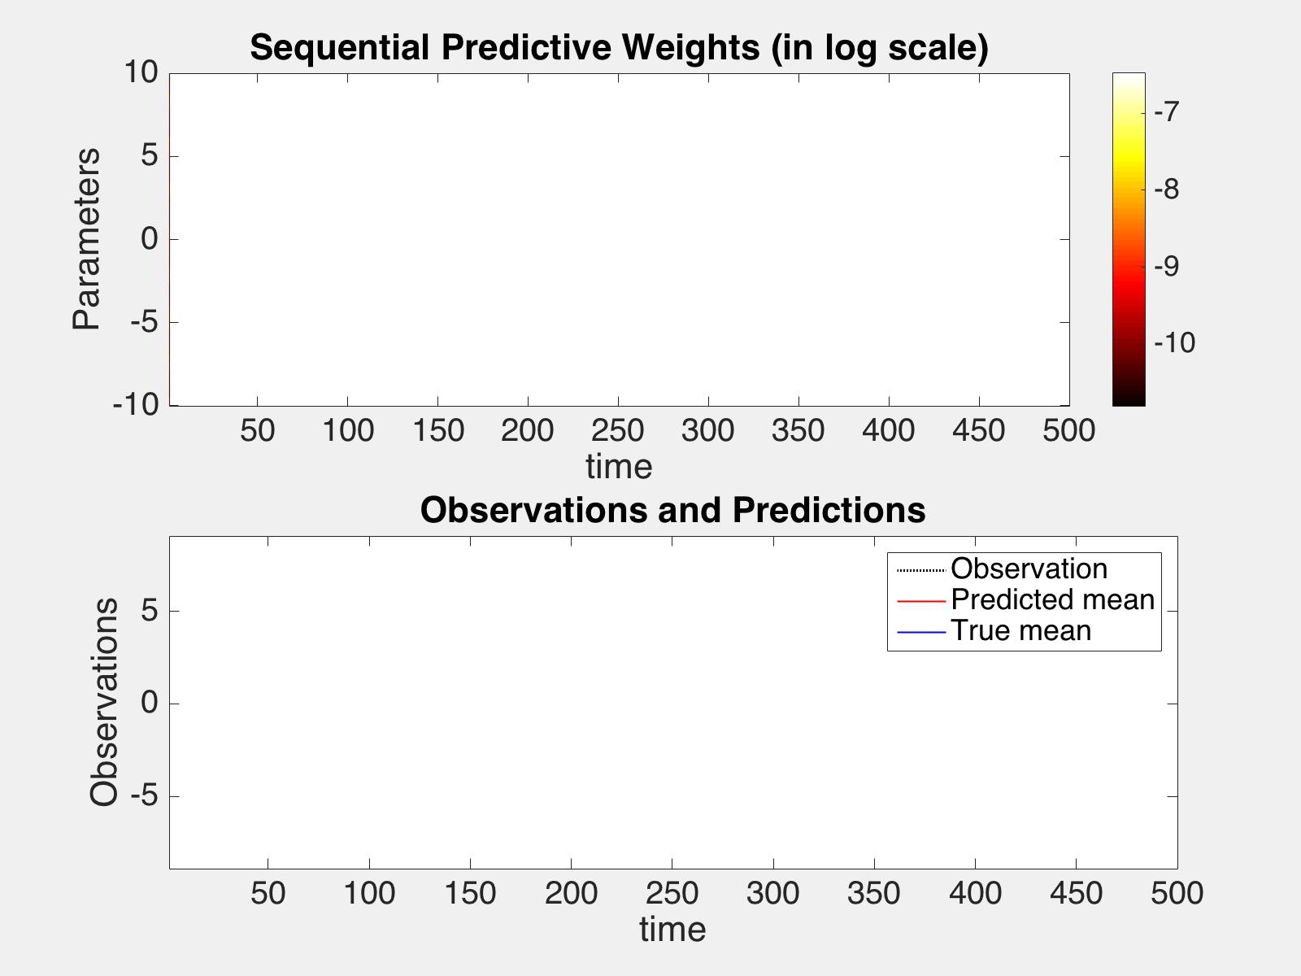
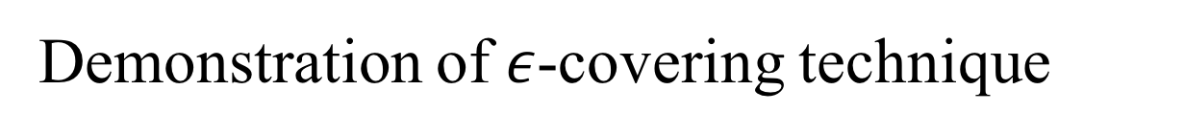
Demonstration of $ε$-covering technique
The predictive distribution on the parameter space at each time step, along with the true time-varying parameters (in blue line)
The observed data (in black dash), together with the time-varying parameters and our predicted expectation (in red lines)

Slide 21
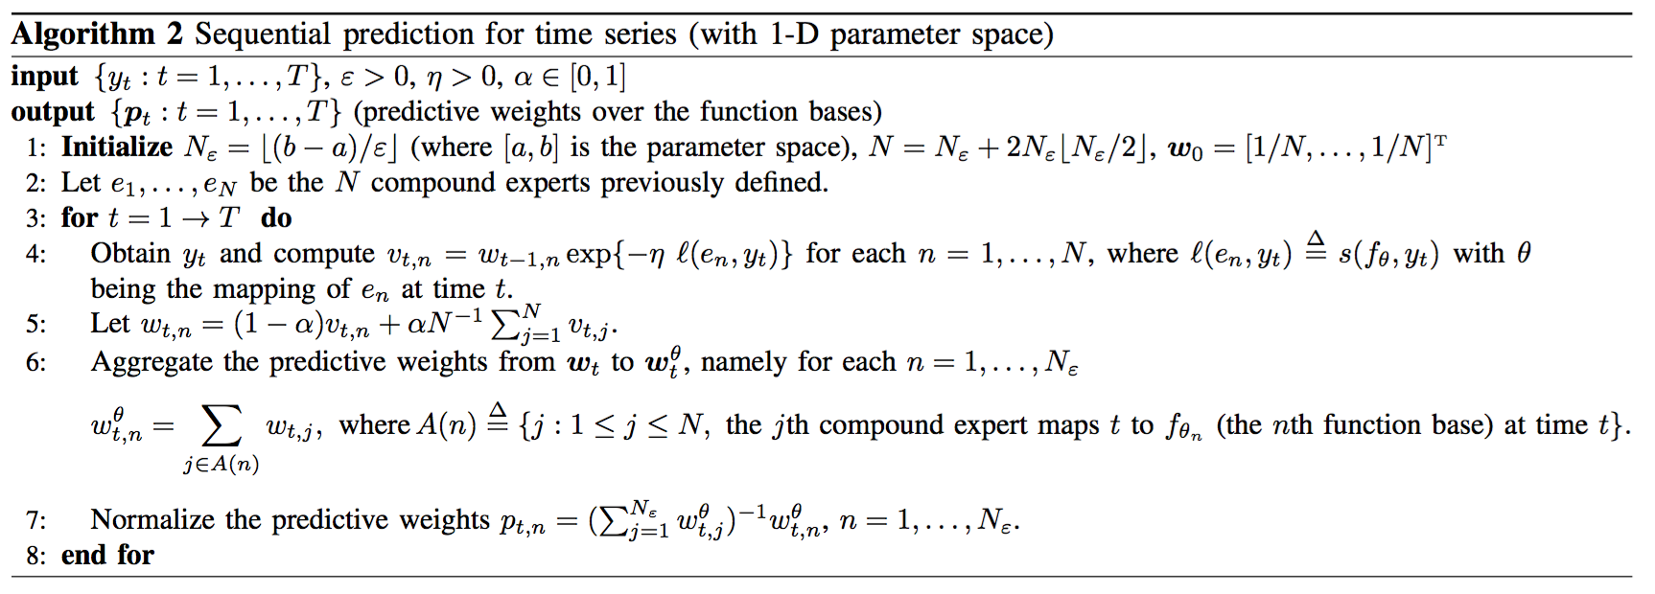

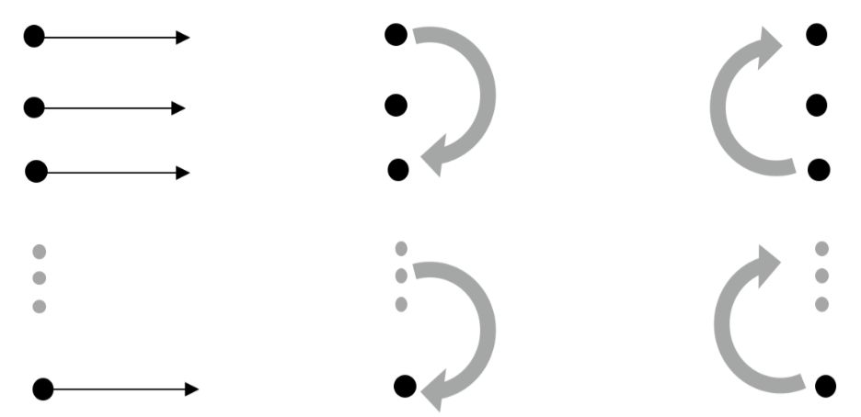
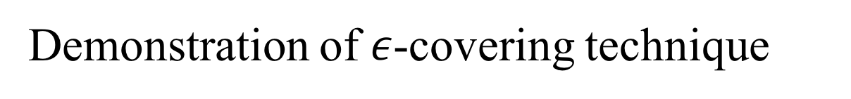
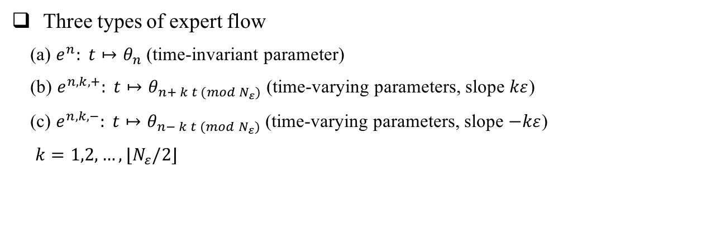
Demonstration of $ε$-covering technique
Three types of expert flow
(a) $e^{n}: t↦θ_{n}$ (time-invariant parameter)
(b) $e^{n,k,+}: t↦θ_{n+ k t (mod N_{ε})}$ (time-varying parameters, slope $kε$)
(c) $e^{n,k,−}: t↦θ_{n− k t (mod N_{ε})}$ (time-varying parameters, slope $−kε$)
$k=1,2,…,⌊N_{ε}/2⌋$

Slide 22
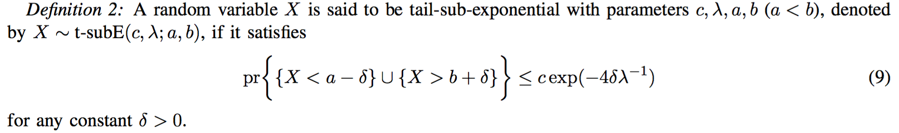
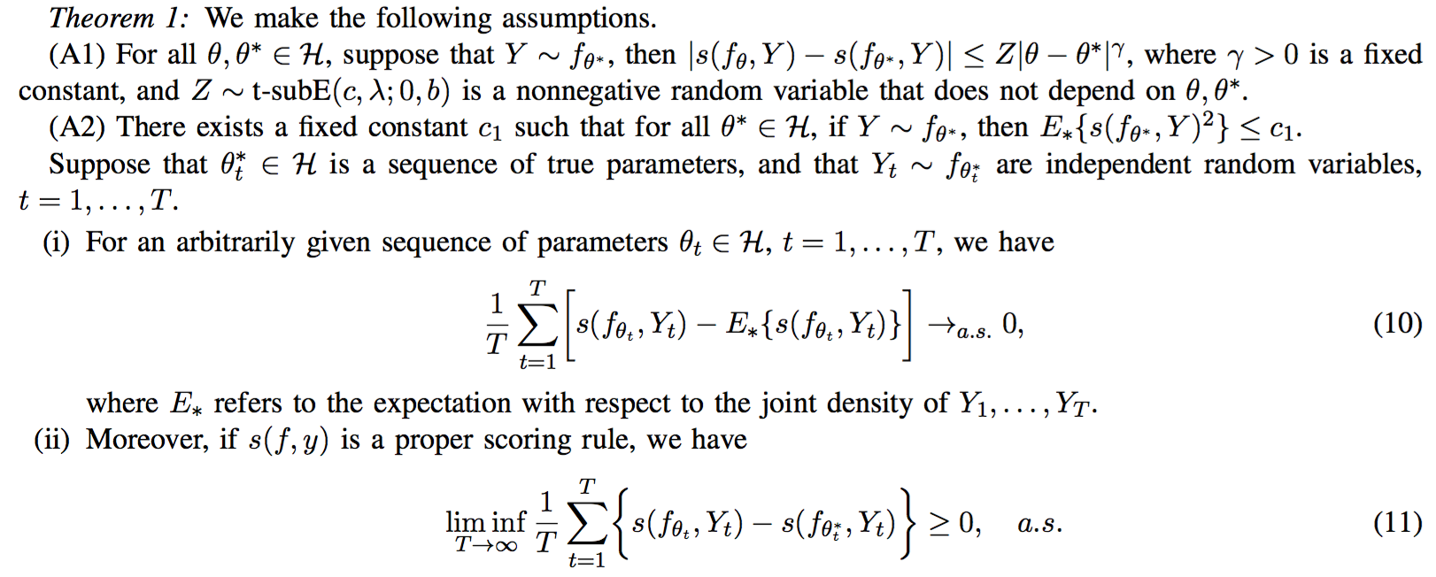
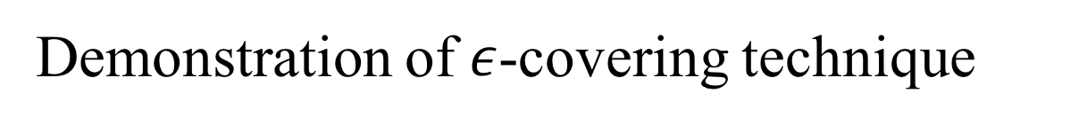
Demonstration of $ε$-covering technique
We prove under reasonable assumptions that
The oracle prediction loss is achieved when the true parameters are known
Our composite score achieves the oracle for sufficiently long time almost surely

Slide 23
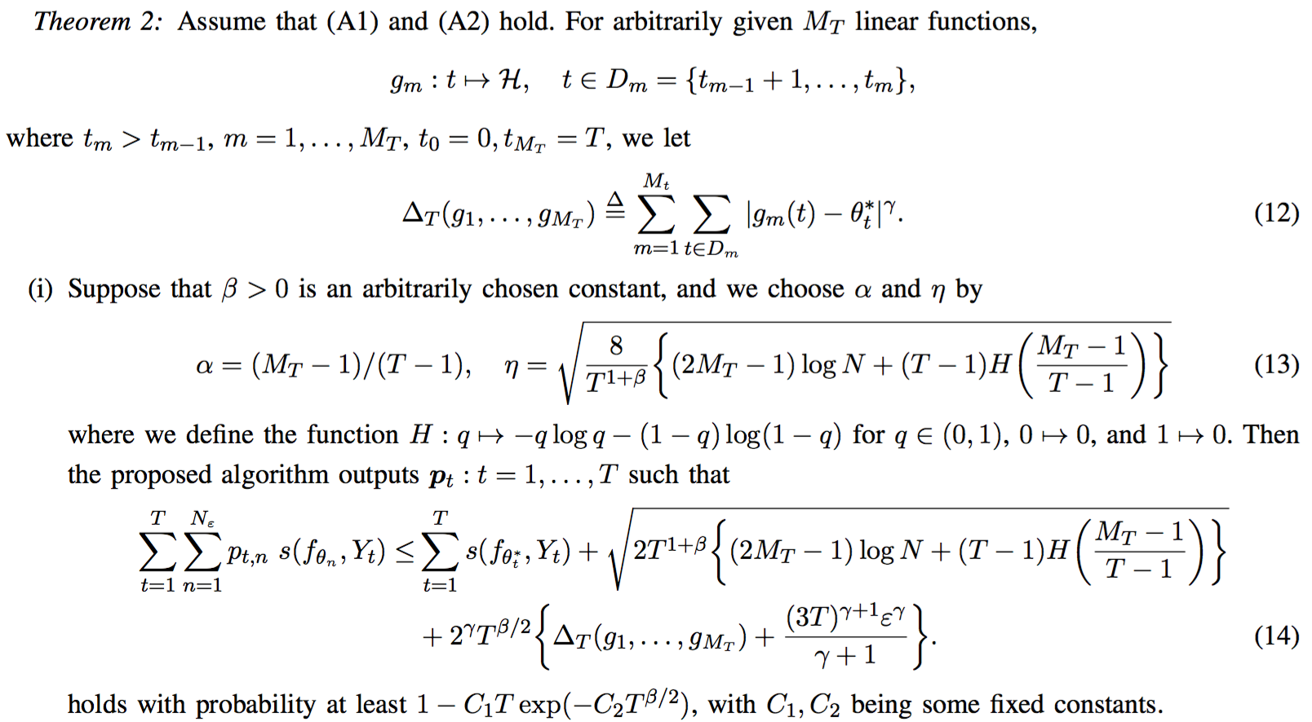
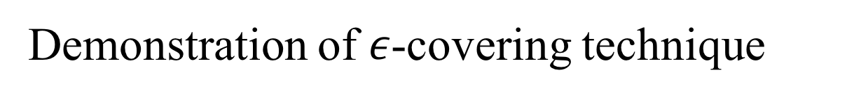
Demonstration of $ε$-covering technique

Slide 24
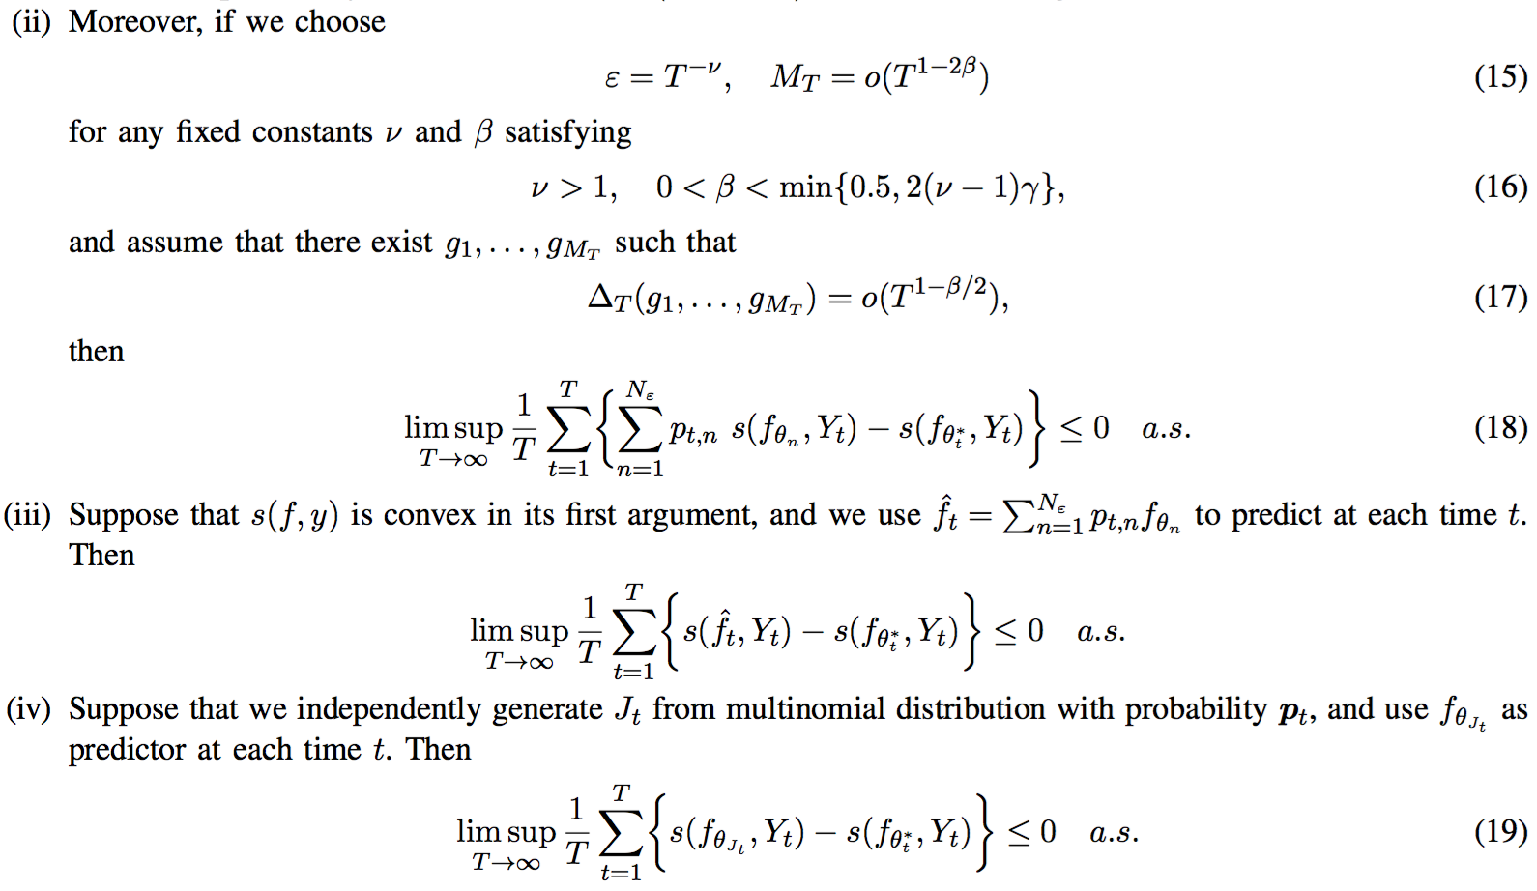
Demonstration of $ε$-covering technique

Slide 25
Experiments
Application to sequential model expansion
Philosophical discussions
Data is sequentially observed on many real applications
Fluctuation of data can change the selected model in an arbitrary manner
The surrogate also requires the model change smoothly
e.g. children brains grow gradually
Candidate model dimensions smoothly and monotonically increase with data
Implementation details
Expert: each candidate model
Maintenance of an active subset at each time (to reduce computational cost)
Switches of the active subset upon the aggregation of data
The output from the algorithm: a set of weights associated with each active model (used to predict the next data point at each time)
Algorithmic description: in the next slide

Slide 26
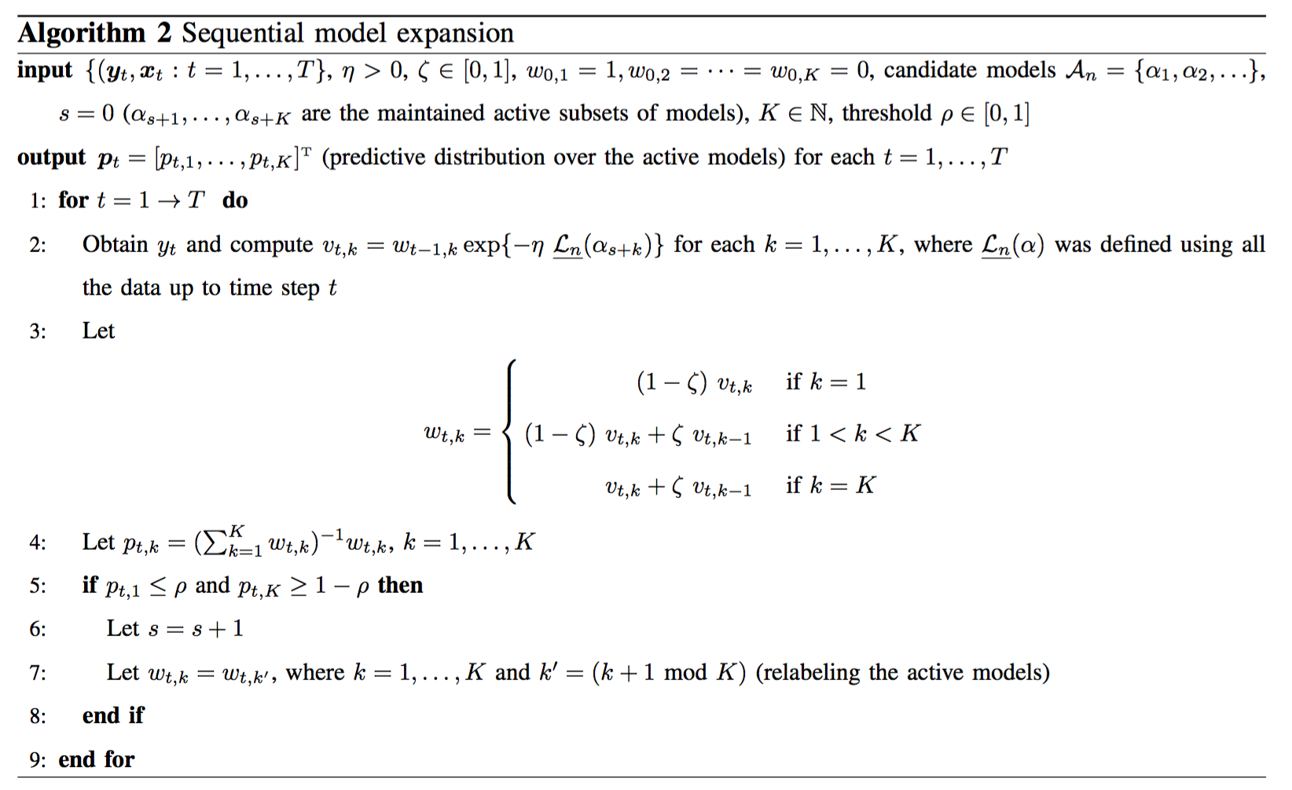
Application: Sequential Model Expansion
Algorithmic description
The algorithm computes LOL in order to smoothly move from small to large models, upon aggregation of data
Smooth change of active models

Slide 27
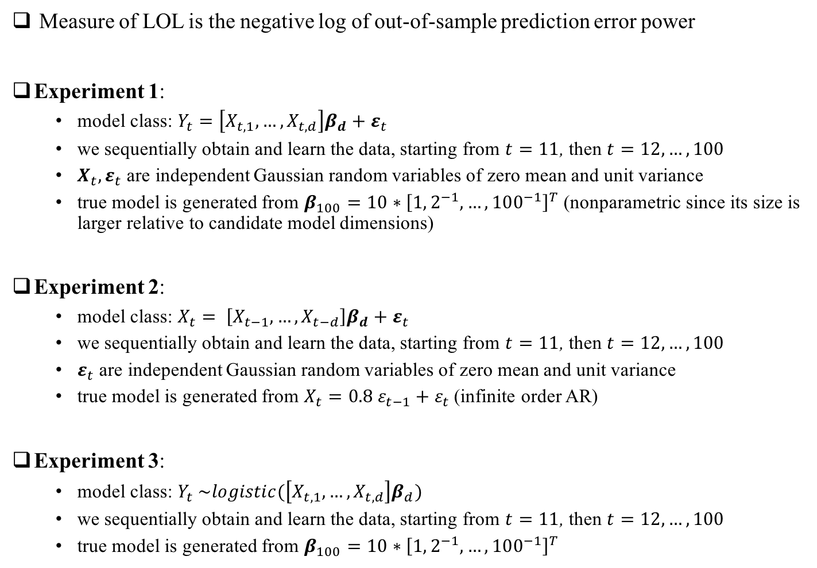
Application: Sequential Model Expansion
Measure of LOL is the negative log of out-of-sample prediction error power
Experiment 1:
model class: $Y_{t}=\left[X_{t,1},…,X_{t,d}\right]β_{d}+ε_{t}$
we sequentially obtain and learn the data, starting from $t=11$, then $t=12,…,100$
$X_{t},ε_{t}$ are independent Gaussian random variables of zero mean and unit variance
true model is generated from $β_{100}=10∗{\left[1,2^{−1},…, 100^{−1}\right]}^{T}$ (nonparametric since its size is larger relative to candidate model dimensions)
Experiment 2:
model class: $X_{t}= \left[X_{t−1},…,X_{t−d}\right]β_{d}+ε_{t}$
we sequentially obtain and learn the data, starting from $t=11$, then $t=12,…,100$
$ε_{t}$ are independent Gaussian random variables of zero mean and unit variance
true model is generated from $X_{t}=0.8 ε_{t−1}+ε_{t}$ (infinite order AR)
Experiment 3:
model class: $Y_{t} \sim logistic(\left[X_{t,1},…,X_{t,d}\right]β_{d})$
we sequentially obtain and learn the data, starting from $t=11$, then $t=12,…,100$
true model is generated from $β_{100}=10∗{\left[1,2^{−1},…, 100^{−1}\right]}^{T}$

Slide 28
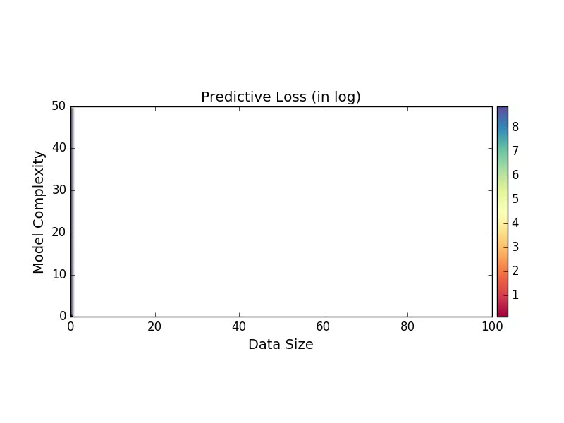
Experiment 2
The prediction loss of estimated candidate models at each data size
the purple pixels correspond to models that cannot be estimated well
the black dots indicate the model of optimal loss at each data size (numerically computed from independently generated test data)
TIC-corrected out-of-sample loss, and independent data

Slide 29
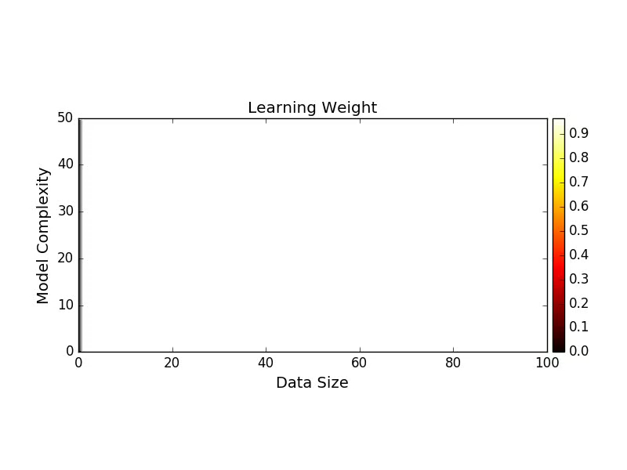
Experiment 2
Our predictive weights over the candidate models at each
blue dots indicate the model of optimal loss at each data size
The active set of models sequentially move from low dimensions to high dimensions,
in a smooth manner, though the optimal models fluctuate along the way (due to data variations)
in fact, even though we know the true optimal models, it is not appropriate to fit a larger model to smaller data

Slide 30
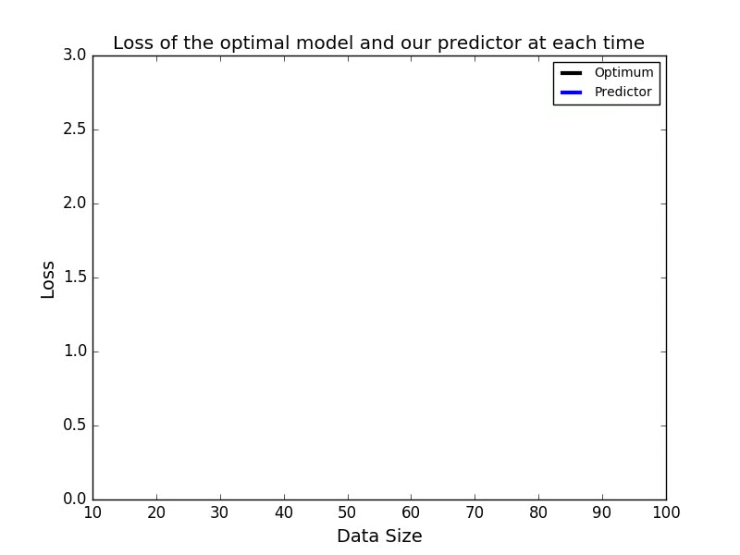
Experiment 2
The loss of our predictive model and compare it with the oracle
it converges as time elapses

Slide 31
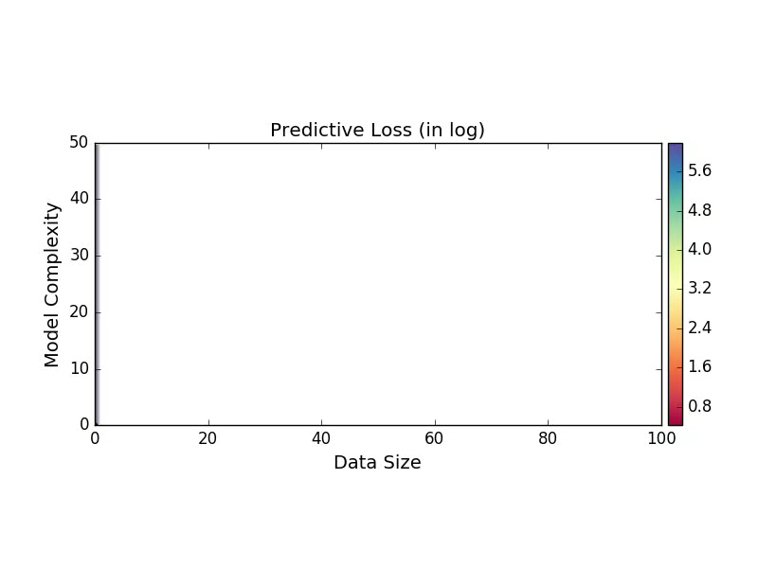
Experiment 3
The prediction loss of estimated candidate models at each data size
the purple pixels correspond to models that cannot be estimated well
the black dots indicate the model of optimal loss at each data size (numerically computed from independently generated test data)
Surrogate: CV-based out-of-sample loss, and dependent data

Slide 32
Experiment 3
Our predictive weights over the candidate models at each
blue dots indicate the model of optimal loss at each data size
The active set of models sequentially move from low dimensions to high dimensions
in a smooth manner, though the optimal models fluctuate along the way (due to data variations)
in fact, even though we know the truly optimal models, it is not appropriate to fit a larger model to smaller data

Slide 33
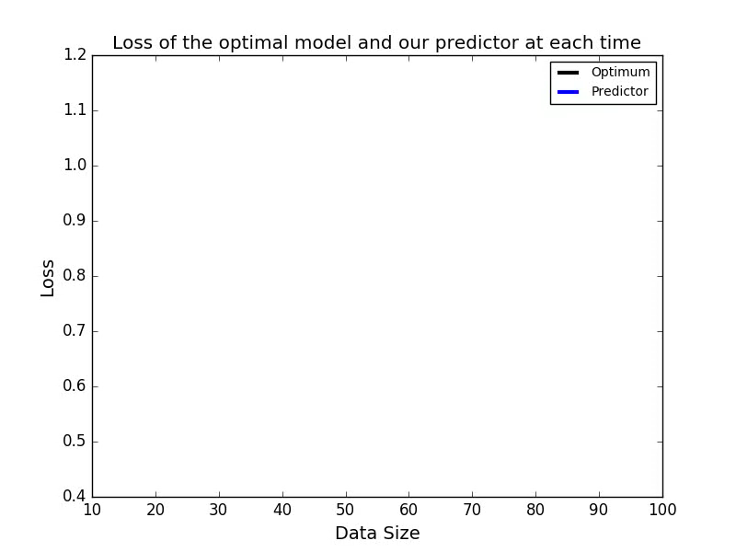
Experiment 3
The loss of our predictive model and compare it with the oracle
it converges as time elapses

Slide 34
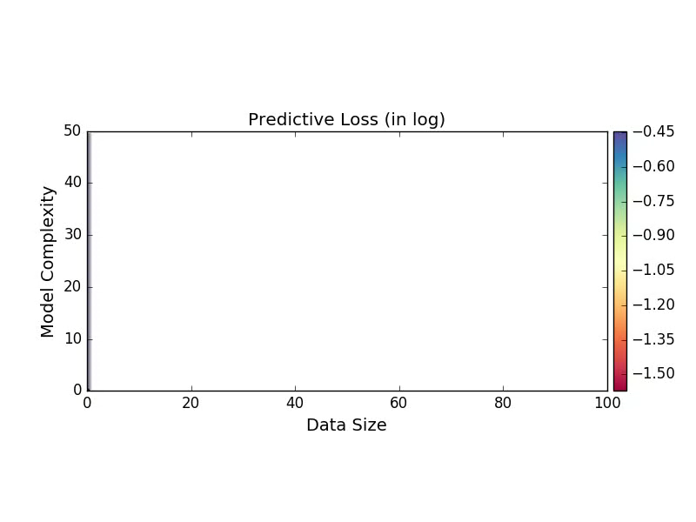
Experiment 4
The prediction loss of estimated candidate models at each data size
the purple pixels correspond to models that cannot be estimated well
the black dots indicate the model of optimal loss at each data size (numerically computed from independently generated test data)
TIC-corrected out-of-sample loss, and independent data

Slide 35
Experiment 4
Our predictive weights over the candidate models at each
blue dots indicate the model of optimal loss at each data size
The active set of models sequentially move from low dimensions to high dimensions
in a smooth manner, though the optimal models fluctuate along the way (due to data variations)
in fact, even though we know the truly optimal models, it is not appropriate to fit a larger model to smaller data

Slide 36
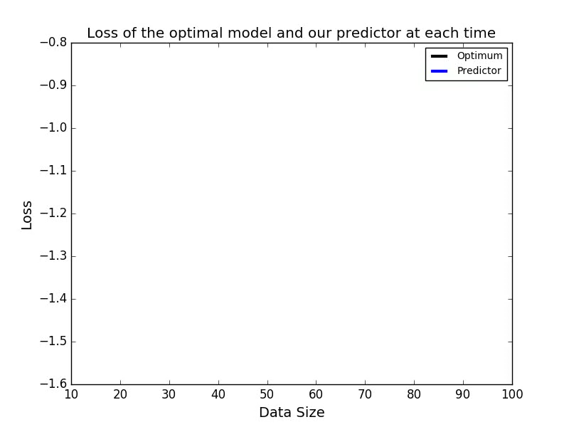
Experiment 4
The loss of our predictive model and compare it with the oracle
it converges as time elapses

Slide 37
Limit of Learning in General
In summary, we have computed LOL for various scenarios:
Given a parametric class
Well-specified: select the right model (vanishing LOL)
Mis-specified: select the best model offered by the class (in terms of LOL)
Not given a parametric class: we apply surrogates of LOL
Ideally: achieving the optimum under all situations?
We believe this is theoretically possible in many scenarios.
In the past, we have established results proving this in some special cases.
For modeling with AR and Regression, the proof given in [1] and [2].
[1] Jie Ding, Vahid Tarokh and Yuhong Yang, "Bridging AIC and BIC: a new criterion for autoregression".
[2] Jie Ding, Vahid Tarokh and Yuhong Yang, “Optimal variable selection in regression models”.

Slide 38
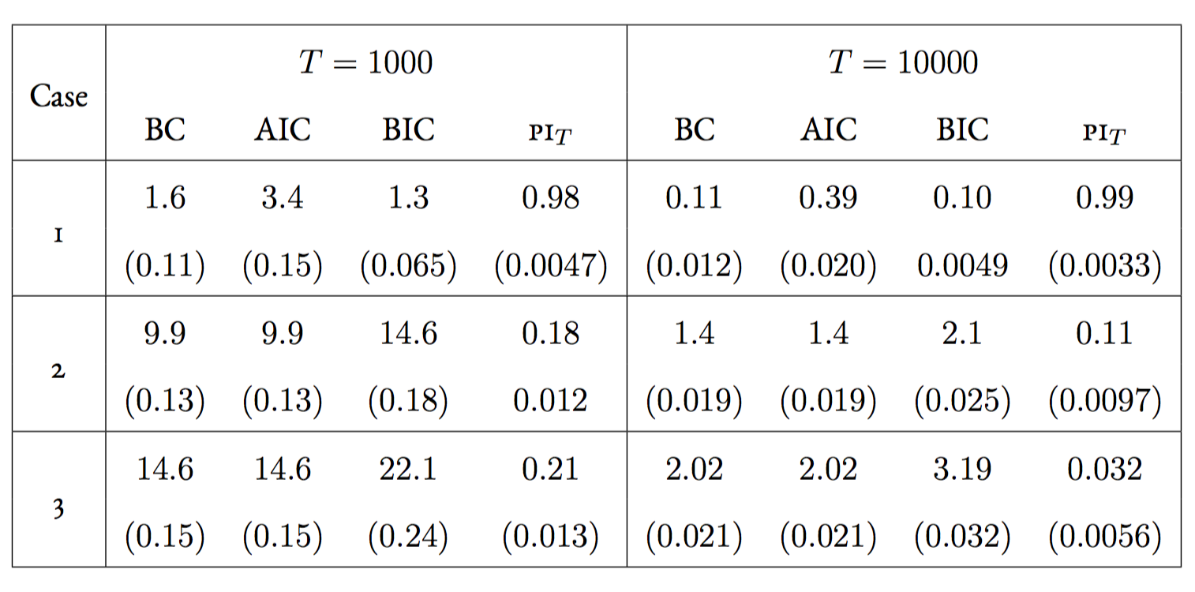
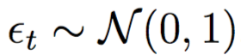
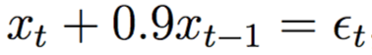
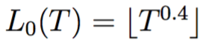
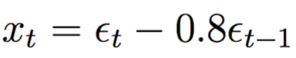
Learning The Optimal Model
Synthetic Data Experiment in the AR case
Table: Prediction risk (and their standard errors) of AR models selected by BC, AIC, and BIC, along with the parametricness index (PI), in three different cases (values except PI and its standard errors were rescaled by 1000), repeated over 1000 experiments.
Case 1 (finite dimensional):
Case 2 (high dimensional):
Case 3 (infinite dimensional):

Slide 39
Limits of Learning and Identifiability

Slide 40
A Pragmatic Interlude
What do we do when reach the limits of identifiability?
That is, we have some data, we have a model, and we cannot identify the parameters.
Example: Clinical Diagnosis
Given ( patient covariates , diagnosis )
Find predicted diagnosis = f( patient covariates , W )
Such That predicted diagnosis ≈ actual diagnosis
What if there are many parameters W that result in the same predictive score/reconstruction quality?
40

Slide 41
A Pragmatic Interlude
What do we do when reach the limits of identifiability?
That is, we have some data, we have a model, and we cannot identify the parameters.
Example: Searching for suspicious objects in images
Given ( image , label of whether object is present )
Find predicted objects = f( image , W )
Such that predicted objects ≈ actual objects
What if there are many parameters W that result in the same predictive score?
41

Slide 42
A Pragmatic Interlude
What do we do when reach the limits of identifiability?
That is, we have some data, we have a model, and we cannot identify the parameters.
Example: Disease Discovery
Given ( patient covariates )
Find embedding W: patient covariates → “disease” values
Such that W⁻¹( disease values ) ≈ patient covariates
What if there are many embeddings W that result in the same reconstruction quality?
42

Slide 43
A Pragmatic Interlude
One Option:
Add constraints to create identifiability
Which constraints to add?
Machine learning models are complex, domain experts who are not machine learning experts might inadvertently cut out useful solutions
Our Approach:
Try to return as many distinct high quality solutions as possible for further inspection by domain experts
43

Slide 44
Example: Differentiable Classifiers
We have a differentiable classifier parametrized by W
y = f( x , W )
(for example, a deep/neural network → consider the clinical diagnosis, suspicious object discovery scenarios from before)
Question: Can we find qualitatively different classifiers?
44

Slide 45
What do we mean by different?
Different: Different Explanations, as defined by input-gradients
∂y/∂x_{d} = ∂f(x)/∂x_{d}
For a data set ( x , y ) and classifier f( x , W ) with parameters W
Compute an additional vector A = binary vector [ ∂f(x)/∂x_{d} > Є ]
Now we have tuples ( x , y , A ) given W
Given a set of weights W, our objective becomes to find another set of weights W' that minimizes
PredictionLoss( { ( f( x , W' ) , y ) } ) Quality
+ lambda * Σ_{n}( A^{W}_{n} * ∂f( x_{n} , W' )/∂x_{nd} )² Different Explanation
Note that it's all differentiable!
(Can easily extend to create n>2 explanations.)
45

Slide 46
Results
On synthetic and real data sets, we can produce multiple classifiers until no more qualitatively different high-quality classifiers exist.
We ran several experiments in which we purposefully contaminated the training data to have patterns not present in test.
46

Slide 47
Results
Our approach consistently finds multiple classifiers, all with high training performance.
Some of them perform well on test—they have fit to the generalizable part of the data—and others do not—they have fit to the contamination.
We argue that in situations where we may not be able to identify the contamination a priori (or we have done our best to eliminate contamination, but there still may be some present), presenting these multiple options to a domain expert to determine which is most likely to generalize well.
47

Slide 48
Example: Bayesian Non-negative Matrix Factorization
We have the following generative model for the data
A ~ Prior( A ) E.g. an exponential distribution
W ~ Prior( W ) E.g. an exponential distribution
X = Likelihood(AW) E.g. AW + Gaussian Noise, Poisson( AW )
where A ≥ 0 is a D by K basis matrix and W ≥ 0 is an K by N weight matrix.
For example, consider the disease discovery example from before, where X is a matrix counting patient billing codes, A represents billing codes associated with certain pathological processes, and W represents how much of each process is present in each patient.
48

Slide 49
Example: Bayesian Non-negative Matrix Factorization
We have the following generative model for the data
A ~ Prior( A ) E.g. an exponential distribution
W ~ Prior( W ) E.g. an exponential distribution
X = Likelihood(AW) E.g. AW + Gaussian Noise, Poisson( AW )
where A ≥ 0 is a D by K basis matrix and W ≥ 0 is an K by N weight matrix.
For example, consider the disease discovery example from before, where X is a matrix counting patient billing codes, A represents billing codes associated with certain pathological processes, and W represents how much of each process is present in each patient.
The posterior p( A , W | X )
can have multiple models and
large connected regions of
similar quality
49

Slide 50
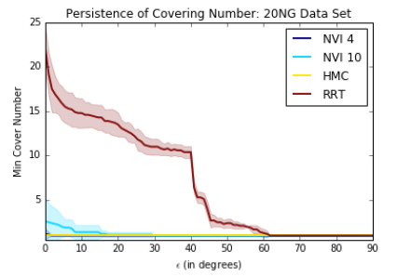
Last Time: Variational Inference with Exploration
We sought to explicitly define an approximation
q( A , W ) ≈ p( A , W | X )
where p( A , W | X ) characterizes our multiple alternatives that we wish to present to the user.
Used rapidly-exploring random trees to search for possible (A,W) pairs to seed a multimodal approximation q( A , W ).
Tricky because want a flexible but non-negative family q( A , W ); have to approximate variational lower bounds to do the inference. Exploration is hard.
50

Slide 51
Update
New evaluation framework: Stein Discrepancy
S( q(x) , p(x) )
= max_{f} { E_{q} [ T_{p} f(x) ] }
for f in some Hilbert Space H, ||f|| < 1
= sqrt( E_{x,x' ~ q} [ K_{p}(x,x') ] )
where K_{p}=T^{x'}_{p} ( T^{x}_{p} k(x,x') );
T^{x}_{p} = dot( grad( log p(x) , f(x) ) + grad( f( x ) )
S( q , p ) = 0 if q = p; only requires samples from
q( A , W ), so we can directly check whether a candidate (A,W) improves the discrepancy.
Also improved our rapidly-exploring random tree search to focus on regions of high p( A , W | X ).
51

Slide 52
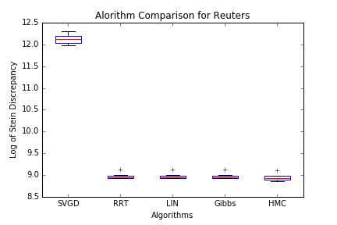
Case #1 : (Probably) just one simple mode…
Algorithms
Stein Variational Gradient Descent (SVGD): Performs Stein variational gradient descent (Liu and Wang, 2016) to produce a set of points to approximate p( A , W | X )
Gibbs, and Hamiltonian Monte Carlo (HMC): Markov Chain Monte Carlo techniques to target p( A , W | X )
LIN: Create candidate points by first sampling a random positive (A,W) and then optimizing via alternating projections. Stream these points in an online fashion, greedily keeping those that improve the discrepancy.
Rapidly-exploring Random Tree (RRT): Starting from an optimized (A,W) pair, use the RRT to expand. As with LIN, stream these points, greedily keeping those that improve the discrepancy.
Produce particles via random restarts optimized via Lin's alternating projections, Gibbs sampling, and HMC.
Observations
Direct gradient descent on a fixed number of particles actually does quite poorly!
When there's just one mode in the data, then other approaches are similar (and HMC does quite well).
SVGD is the slowest; then HMC. Gibbs is the fastest. LIN and RRT have similar running times.
52

Slide 53
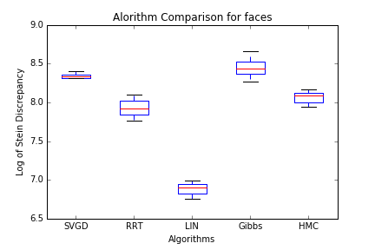
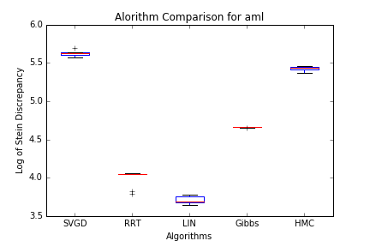
Case #2 : (Probably) many modes...
Observations
In other problems, the modes appear to be more complex. RRT does a better job of exploring them compared to HMC and Gibbs.
However, RRT still cannot find disconnected regions, which tend to be farther apart and only findable by algorithms such as LIN, which use random restarts. Finding a far-away point dramatically reduces the Stein discrepancy, more than just better local exploration.
53

Slide 54
Limits of Learning In Cognitive Settings

Slide 55
To Understand Computations in the Brain
Some much simpler questions than those of generalization (as treated by learning theory) need to be understood first.
How are concepts represented? How is a new concept given a representation? How are concepts linked as we acquire facts?
e.g. If a concept is represented by a particular set of neurons how is the assignment to a new one made?
Approach: the sparsity of connections and the weakness of many synapses sets up a quantitative tension between the amazing functionality and the weakness of the computational substrate.
Amazing functionality here = Ability to learn hundreds of thousands of concepts and their relations in sequence over a lifetime with limited degradation of earlier one.

Slide 56
To Understand Computations in the Brain
The Neuroidal Model of Computation Like McCulloch-Pitts but more programmable (states, timing) e.g. for timing-dependent plasticity, and more quantitative.
Resource Bounds: n neurons (with states), each connected to d others, with max. synaptic weights 1/k × threshold.
Local Updates to states and synapses …..
Timing: Inputs to neurons can be activated simultaneously by a prompt. Neurons have local timing mechanism which can keep them in sync. for a few steps.
Intended to strictly underestimate computational capabilities of cortex, not to “model” it in the sense of applied mathematics.

Slide 57
To Understand Computations in the Brain
Want to find systems level primitives of cortex: Here consider: Association as a task of circuit formation (not conventional autoassociation, dictionary lookup etc.)
Consider concepts “Donald Trump” and “President” to have been assigned a set of neurons already. What does cortex change so that in the future whenever the neurons for the former are active those of the latter will automatically become so?
(e.g. want to represent the change that now Donald Trump → President)
Definition of Association: For any stored items A, B, change synaptic weights so that in future whenever A is active then B will be caused to be also.

Slide 58
Network Requirement for Association on Random Graph
r
Donald
Trump
A
k
C
r
President
n = no. of nodes in network
d/n = prob. of edge
r = no. of nodes for a concept
k = min. no. of inputs to fire a node
n
k

Slide 59
To Understand Computations in the Brain
Bounds on Capacity, the number of associations that can be memorized, each with one-shot learning, without significant degradation
Finding: If the associations are composable, (i.e. you can chain several in your mind), which implies that the number of neurons R of the trigger A is the same as the number of neurons r of the target B, then for the simplest mechanism (acting across just one layer) the capacity is degraded.
For simplicity we give the theorem for one (paradigmatic) instance, when each neuron has d = √n connections for an n neuron system.
Theorem: If the associations are to be composable, i.e. r=R, then the capacity for the one layer algorithm grows as ~n, otherwise it may grow as ~n^{3/2}. In both cases these are both upper and lower bounds.
Next: To consider more complex algorithms with better composable capacity.

Slide 60
Future Work
LoL and predictive power in more general settings:
Nonparametric model class
Dependent data
Shannon’s type formulas
Computational methods
Limit achieving algorithms
LoL with Adaptive selection of loss functions
LoL with Time-varying loss functions
More examples of non-identifiability
Exploration of connectivity and non-connectivity in alternate sets of parameters.
To consider more complex algorithms with better composable capacity.

Slide 61
Backup Slides
Backup Slides

Slide 62
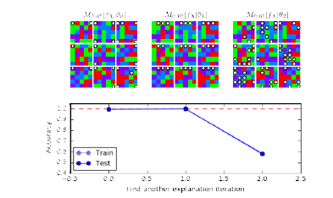
Results
In this toy problem, there are two ways to separate the classes: by looking at the four corners or by looking at the three center pixels in the top row.
We see that we first find a solution W with good accuracy, (corners), then a solution W' with good accuracy (top center), and then predictive performance degrades because there are no more distinct classifiers left.
62

Slide 63
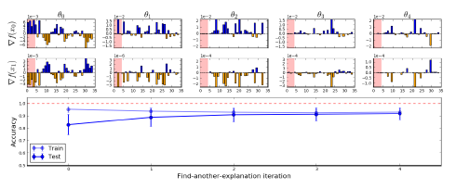
Results
Here we pollute a UCI data set, Cancer, by concatenating another UCI data set, Iris, in training by aligning labels (that is, we generate data by concatenating pairs x-Cancer and x-Iris if they have the same binary y label). In test, Iris labels no longer align.
We see that we can find many classifiers with similar predictive performance in training. However, the first classifier does poorly in test because it had trained to Iris, rather than cancer features – something that hopefully a domain expert would catch!
63

